Slide 1

ZFS
Is the jam!

Slide 2
NOT JUST A fILE SYSTEM
Headline: A File system & a logical volume manager in one
Traditional hardware raid array displays a single volume while os/kernel has in unaware of how the physical volumes are managed
Even with traditional software raid schemes, the software processes responsible for merging physical disks is separate from the file system
Zfs has complete knowledge of both physical disks and volumes
Condition/status
Logical arrangement
The files stored on them
FIle-Stack?

Slide 3

Tl;dr of zfs history
Developed by Sun Microsystems as a filesystem for solaris at the turn of the century
It was initially open source
Oracle acquired Sun and made it closed source for a short time
It then forked to the OpenZFS project
FreeBSD was early to implement production support
Linux distributions were slower to adopt
Conflicts with license types?

Slide 4
Other big advantages
Checksumming of data to verify integrity
Hierarchical: checksum of a block is stored within the parent block
Native data compression
Deduplication
Snapshots
Files/directories
Operating system
Copy-on-Write

Slide 5
Disadvantages
Ram hungry
Minimum 1GB ram for every 1TB of storage
Even more when utilizing deduplication
Deduplication can slow performance as a tradeoff for space-saving
Memory corruption could theoretically cause more catastrophic results than other filesystems

Slide 6
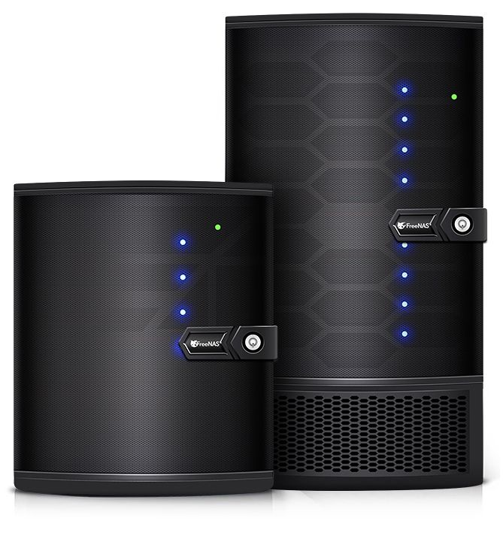
ZFS RAID MODES
Stripe: Same as a traditional RAID-0 stripe configuration
Mirror: Same as a traditional RAID-1 stripe configuration
Raid-z: Data-Parity scheme, similar to RAID-5
RAIDZ1
Up to 1 Disk can be lost
RAIDZ2
Up to 2 Disks can be lost
RAIDZ3
Up to 3 Disks can be lost

Slide 7
Advantages of RAIDZ
Dynamic stripe width: Every block is its own raid stripe regardless of size
Eliminates the write-hole error
Self-healing
Reads checksum as a block read is requested
Repairs a damaged block as encountered and subsequently serves it up
Stripes are different sizes, so access to filesystem metadata is needed to determine the raid-z geometry
Would not be possible unless a single system had direct access to both the volume manager and the file system
More efficient
More robust
Can rebuild a volume much faster than traditional raid schemes
Access to filesystem geometry allows zfs to copy and verify only the minimum data needed to restore the array to full operation

Slide 8

Lets Jump In The Pool!
Since it’s neither just a volume or a partition, zfs vernacular refers to them as ‘pools’
Let’s create a pool with four ‘disks’
truncate -s 64MB vdisk1
truncate -s 64MB vdisk2
truncate -s 64MB vdisk3
truncate -s 64MB vdisk4
ls -la
zpool create demopool raidz /tmp/zfsdemo/vdisk1 /tmp/zfsdemo/vdisk2 /tmp/zfsdemo/vdisk3 /tmp/zfsdemo/vdisk4
zfs list | grep -v zroot | grep -v boot

Slide 9
DYNAMIC SIZING & REAL-TIME COMPRESSION
What would be a logical partition in other filesystems would have to be a fixed size
Each ‘dataset' within a ZFS pool has no set size and shares the total space of the pool with the others
Each one can be configured with a different compression method
Let’s make some DATASETS!
zfs create demopool/stuff
zfs create -o compression=lz4 demopool/stuff/textfiles
zfs create -o compression=gzip demopool/stuff/webfiles
zfs create -o compression=lzjb demopool/stuff/logfiles
zfs get -r compression demopool
zfs list | grep -v zroot | grep -v boot

Slide 10
I MADE YOU… I CAN DESTROY YOU…
You can discard a specific dataset within a ZFS pool with the zfs destroy command
You can discard an entire ZFS pool with the zpool destroy command
Let’s make one more dataset within our existing pool and one more ZFS pool and destroy them both!
zfs create demopool/stuff/pornfiles
truncate -s 64MB vdiska
truncate -s 64MB vdiskb
zpool create kiddiepool mirror /tmp/zfsdemo/vdiska /tmp/zfsdemo/vdiskb
zfs list | grep -v zroot | grep -v boot
zfs destroy demopool/stuff/pornfiles
zpool destroy kiddiepool

Slide 11

SNAPSHOTS
One of the most powerful features of ZFS
Have existed in other systems (NetApp… Apple Time Machine…), but arguably one of the best implementations
Only stores the delta of changed files… and not until the file actually changes
Manifested by pointers to previously existing blocks
Full dataset manipulation
Restore in full… backup to another machine…
Hidden .zfs folder
Allows you to traverse and manipulate files and folders as they existed in a previous point in time

Slide 12

DELTA DELTA DELTA… CAN I HELP YA HELP YA HELP YA?
Let’s make some snapshots!
First we’ll create a mock file within one of our datasets
Then we’ll create a snapshot of the dataset that contains the file
Lastly we’ll modify the file and see how ZFS uses deltas and pointers to allow us access previous versions with minimal space usage
Demonstrate recursive snapshots of all datasets within a given pool
dd if=/dev/random of=/demopool/stuff/demofile bs=1m count=10
cd /demopool/
ls -Rlh
zfs snapshot demopool/stuff@2019070501
zfs list -t all -o name,used,refer,written | grep -v zroot | grep -v boot
dd if=/dev/random of=/demopool/stuff/demofile bs=1m oseek=5 count=10
zfs list -t all -o name,used,refer,written | grep -v zroot | grep -v boot
ls -la
zfs snapshot -r demopool@2019070502
zfs list -t all -o name,used,refer,written | grep -v zroot | grep -v boot

Slide 13

Gonna go back in time!
Let’s roll BAcK OUR SNAPSHOT And SEE IF THINGS ARE THE WAY THEY WERE BEFORE WE cHANGED ANYTHING
We are “master of the undo button”!
zfs rollback -r demopool/stuff@2019070501
cd /demopool/stuff
ls -la

Slide 14
.zfs: Portal to the Past
Each dataset has a hidden .zfs directory
Within that is a ‘snapshots’ subdirectory
Further within that is a subdirectory corresponding to every snapshot of the given dataset
Within that you can navigate the full file and directory structure as it appeared at the time the snapshot was created
dd if=/dev/random of=/demopool/stuff/demofile bs=1m oseek=5 count=10
cd /demopool/stuff/.zfs
ls -la
cd snapshot
ls -la
cd 2019070501
ls -la
cp demofile /demopool/stuff/demofile.original
cd /demopool/stuff/
ls -la

Slide 15
Snapshots in the real world: Automating with cron
Script runs the zfs snapshot command at regular intervals
In this example, each snapshot contains a copy of my home directory and tmp directory
We can literally review my activity in this directory over time
cat /etc/crontab | grep snapshot
zfs list
cd /usr/home/
cd .zfs/
cd snapshot/
ls
ls -l */fongaboo/tmp/ | more
./auto-snap
n

Slide 16
Sending and Receiving Snapshots
Snapshots can be piped to a file or other commands
Useful for offsite backups or manual replication of a filesystem
zfs snapshot demopool/stuff@offsite_bak
zfs list -t all -o name,used,refer,written | grep -v zroot | grep -v boot
zfs send demopool/stuff@offsite_bak > /tmp/zfsdemo/stuff.backup.zfs
cd /tmp/zfsdemo/
file stuff.backup.zfs
zfs receive -v demopool/stuff_restored < /tmp/zfsdemo/stuff.backup.zfs
zfs list -t all -o name,used,refer,written | grep -v zroot | grep -v boot
cd /demopool/stuff_restored/
ls -la
zfs send demopool/stuff@offsite_bak | ssh <user>@<hostname> zfs receive -v <other-server’s-pool>/stuff_received

Slide 17

Give it a Good Scrub
ZFS has no equivalent to fsck or Apple Disk Utility First Aid
Instead uses a built-in ‘scrub’ function
Checks all data at block and file level for corruption
Just a batch of the checksum check and repair that happens on the fly
Advantages
Can run while the filesystem is online
Other filesystems can’t make direct connections between the file structure and the volume structure; Limited to journals, etc.; Only check metadata
Checksums are stored separate from the data; Reduces the risk of both data and checksum being corrupted
Disadvantages
Slower than fsck; traverses all metadata and data; Can take several hours
Can be automated with cron

Slide 18
Drop it like it’s hot!
Let’s check the health of the pool with ‘scrub’ and ‘status’
Let’s simulate a disk failure
Let’s simulate replacing the bad disk and ‘resilvering’ the pool
zpool scrub demopool
zpool status demopool
cd /tmp/zfsdemo/
srm -v vdisk3
zpool scrub demopool
zpool status demopool
truncate -s 64MB vdisk3
ls -la
zpool replace demopool <vdev ID> /tmp/zfsdemo/vdisk3
zpool status demopool
zpool status demopool

Slide 19

Room for Expansion
Mirrored pools
Drives can be replaced with larger drives
ZFS will resilver data in-place and add the extra space to the pool
RAIDZ Pools
Existing Drives cannot be replaced in-place with larger drives
Additional drives can be added to the pool
ZFS will resilver data in-place and add the extra space to the pool

Slide 20
Boot Environments
Particular use of ZFS snapshots specifically for the operating system
Utilized through a utility called ‘beadm’
Create a beadm snapshot just prior to a major upgrade
a snapshot is automatically created containing all crucial system files that make up the operating system and software
Reboot
If upgrade does not go as planned, initiate restore of the beadm snapshot and reboot again
beadm create 2019070501_DemoEnvironment_JC
beadm list
beadm activate
shutdown -r now
beadm create 2019070501_DemoEnvironment_JC
beadm list

Slide 21
Deduplication
Greatest ‘double-edged sword’ of ZFS
Saves space
Takes tons of RAM
Slows performance
Allows you to store the same data multiple times but use only the space of a single copy
zfs create demopool/stuff/syncthingfiles
zfs list -t all -o name,used,refer,written | grep -v zroot | grep -v boot
zfs set dedup=on demopool/stuff/syncthingfiles
zfs list -t all -o name,dedup | grep -v zroot | grep -v boot
cd /demopool/stuff/syncthingfiles/
truncate -s 4MB file4chad
ls -la
cp file4chad file4glenn
ls -la
dd if=/dev/random of=/demopool/stuff/syncthingfiles/file4kyle bs=1m count=4
ls -la
zfs list -t all -o name,used,refer,written | grep -v zroot | grep -v boot

Slide 22
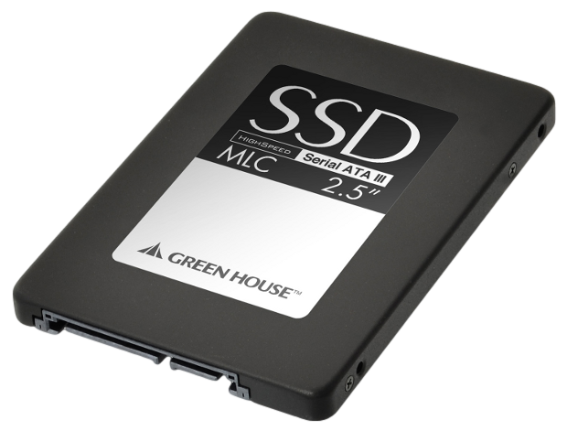
Cold Hard Cache
First a word on ZFS and RAM:
It’s often said that ZFS requires ECC RAM
ECC RAM is memory with error correction functionality onboard
Slight Achilles heel: A write from a memory corruption could possibly spiral into corruption of an entire pool
Adaptive Replacement Cache (ARC)
ZFS sets aside a certain amount of ram for caching of often-accessed data
A Fast storage device such as an SSD can be added to a pool to provide more cache
Only useful in specific use-cases
Redundant files accessed by multiple users (ie. Database or a NAS with PDF/DOC files)
Not useful for highly entropic data (ie. Video files)

Slide 23
Bibliography
BSDNow Podcast: A Crash Course on ZFS
http://5h0w.me/bsdnowzfs
Wikipedia: ZFS
http://5h0w.me/wikizfs
Wikipedia: History and Implementations of ZFS
http://5h0w.me/wikizfshistory
FreeBSD Handbook: ZFS Administration
http://5h0w.me/freebsdzfs
Discovering ZFS: Pros and Cons Comparing to a Traditional Filesystem
http://5h0w.me/zfsproscons
Louwrentius: Please Use ZFS with ECC Memory
http://5h0w.me/zfsecc

